Slide 1

Network Models & Protocol Architectures
Lecture 2 | Part 1 of 4 | CSE421 – Computer Networks
Department of Computer Science and Engineering School of Data & Science

Slide 2
Objectives
Layering in communication
Protocols
Standards
Protocol Suites
OSI Model
TCP/IP Model
Addressing

Slide 3
Layering
Tasks of communication are broken up into layers
Communication
Layer 1
Layer 2
Layer 3

Slide 4


Layers: Sending a letter
The letter is written, put in an envelope, and dropped in a mailbox.
The letter is picked up, removed from the envelope, and read.
Higher layers
The letter is carried from the mailbox to a post office.
The letter is carried from the post office to the mailbox.
Middle layers
The letter is delivered to a carried by the post office
The letter is delivered from the carrier to the post office.
Lower layers
The parcel is carried from the source to the destination

Slide 5
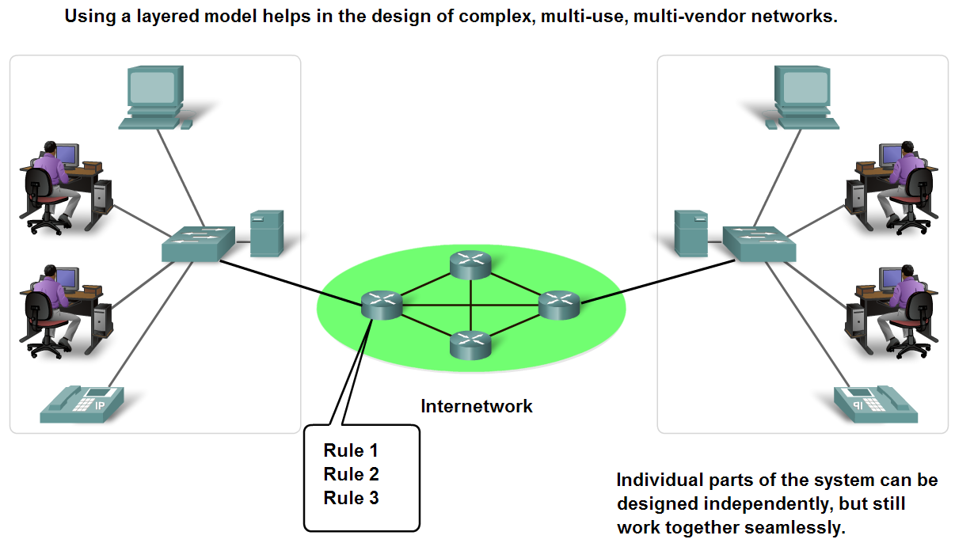
Benefits of using a layered model
Fosters competition.
Technology changes in one layer do not affect other layers.
Each layer have defined functions that they act upon.

Slide 6
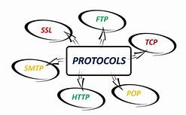
Protocols

Slide 7
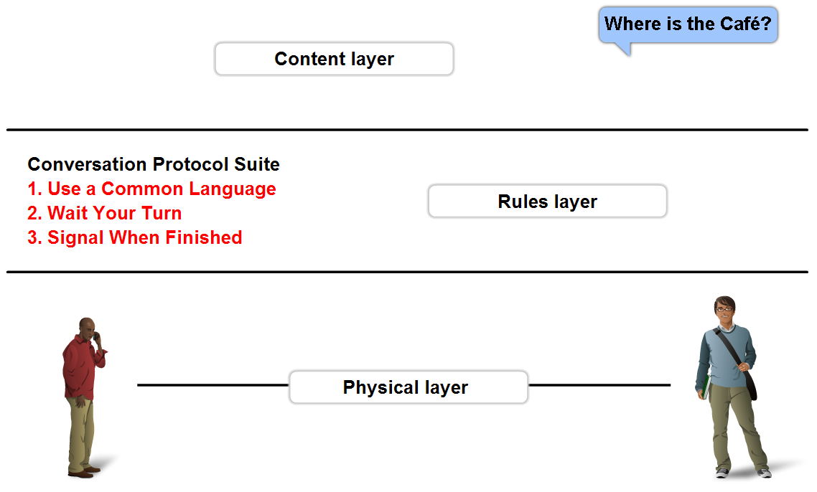
Protocols
All communications are governed by protocols
Protocols are the rules that communications will follow.
These rules will vary depending on the protocol.

Slide 8
Protocols
Protocols must account for the following requirements:
An identified sender and receiver
Common language and grammar
Speed and timing of delivery
Confirmation or acknowledgment requirements
Common computer protocols must agree in:
Message encoding
Message formatting and encapsulation
Message size, timing, delivery option.

Slide 9

Standards

Slide 10
Standards
Standards
Standards Organizations
Internet Standards

Slide 11
Standards
Endorsed by the networking industry and approved by a standards organization.
Benefits:
Create and maintain an open and competitive market.
Ensured greater compatibility and interoperability.
Categories
De facto – TCP/IP Protocol Model
De jure – OSI Reference Model

Slide 12

Open Standards
Open standards encourage:
Interoperability
Competition
Innovation
Standards organizations are:
vendor-neutral
non-profit organizations
established to develop and promote the concept of open standards.

Slide 13
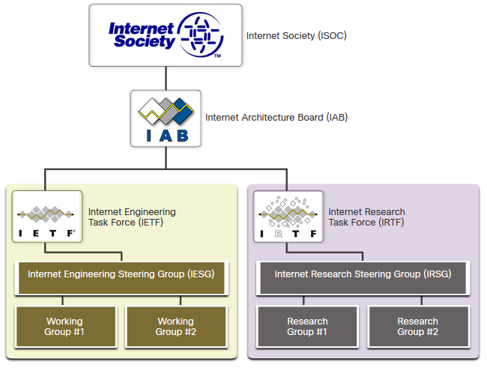
Internet Standards
Internet Society (ISOC) - Promotes the open development and evolution of internet
Internet Architecture Board (IAB) - Responsible for management and development of internet standards
Internet Engineering Task Force (IETF) - Develops, updates, and maintains internet and TCP/IP technologies
Internet Research Task Force (IRTF) - Focused on long-term research related to internet and TCP/IP protocols

Slide 14
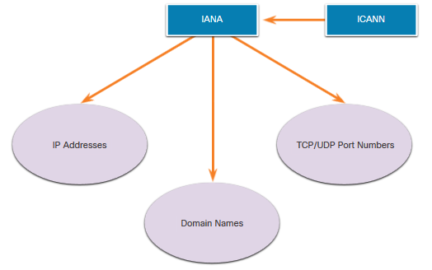
Internet Standards (Continued)
Standards organizations involved with the development and support of TCP/IP
Internet Corporation for Assigned Names and Numbers (ICANN) - Coordinates IP address allocation, the management of domain names, and assignment of other information
Internet Assigned Numbers Authority (IANA) - Oversees and manages IP address allocation, domain name management, and protocol identifiers for ICANN

Slide 15
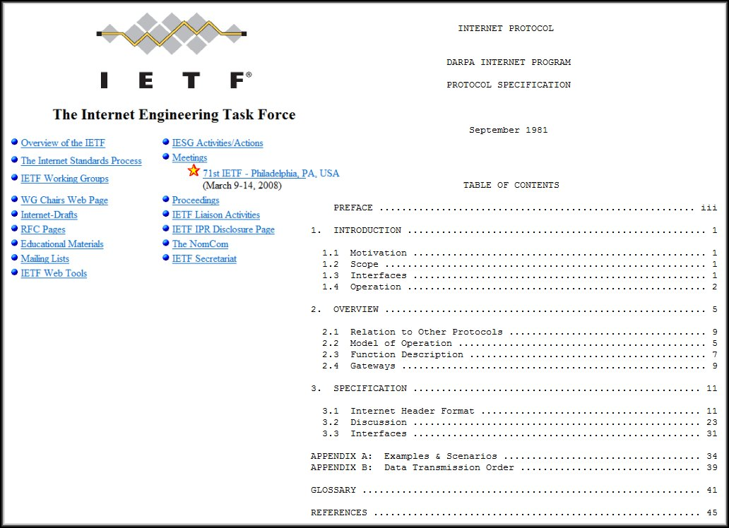
Internet Standards (Continued)
Formalized regulations and specifications for the Internet by IETF.
Internet Draft
No official status
6 month lifetime
Request for comment (RFC)
Upon recommendation from Internet authorities
Different maturity levels
Example: Internet Protocol – RFC : 791

Slide 16
Electronic and Communications Standards
Institute of Electrical and Electronics Engineers (IEEE, pronounced “I-triple-E”) - dedicated to creating standards in power and energy, healthcare, telecommunications, and networking
Electronic Industries Alliance (EIA) - develops standards relating to electrical wiring, connectors, and the 19-inch racks used to mount networking equipment
Telecommunications Industry Association (TIA) - develops communication standards in radio equipment, cellular towers, Voice over IP (VoIP) devices, satellite communications, and more
International Telecommunications Union-Telecommunication Standardization Sector (ITU-T) - defines standards for video compression, Internet Protocol Television (IPTV), and broadband communications, such as a digital subscriber line (DSL)

Slide 17
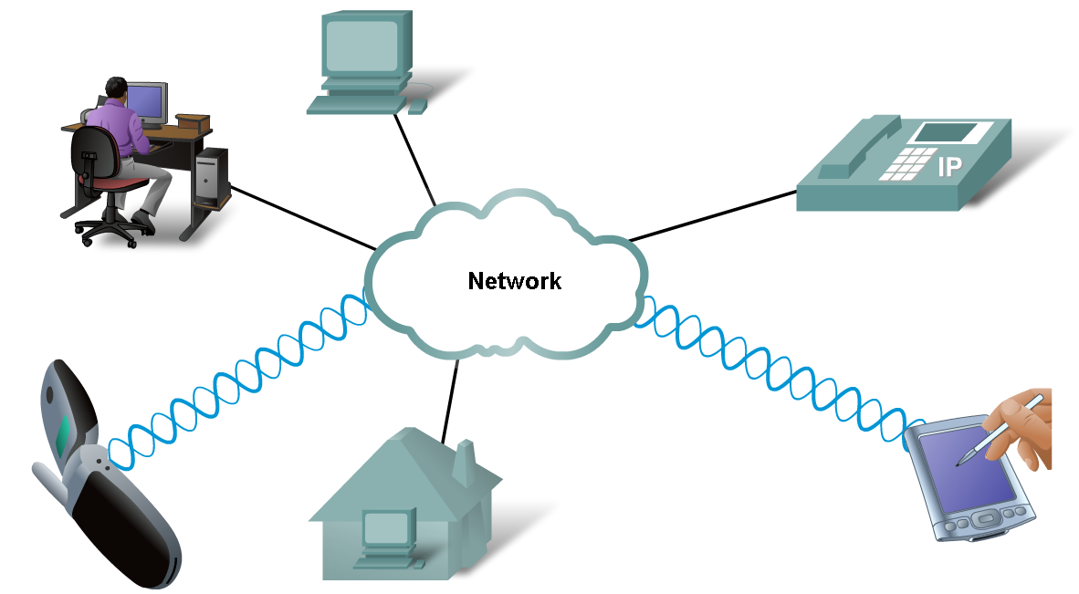
Technology Independent Protocols
Protocols are not dependent upon any specific technology.
They describe what must be done to communicate but not how its is to be carried out.

Slide 18
Network Models & Protocol Architectures
Lecture 2 | Part 2 of 4 | CSE421 – Computer Networks
Department of Computer Science and Engineering School of Data & Science

Slide 19
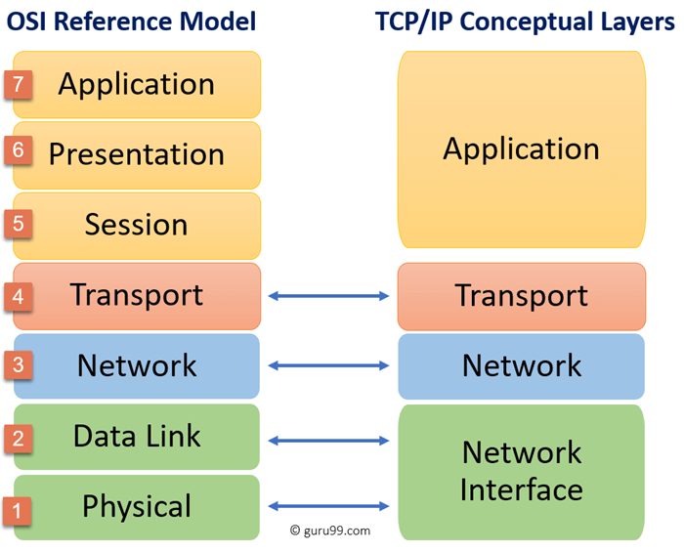
Protocol Suites

Slide 20
Protocol Suites
TCP/IP Protocol Model
Open De Facto Standard
Governed by IETF Working Groups
OSI Reference model
De Jure Standard

Slide 21
OSI Model De Jure Standard
Layers
7 | Application
6 | Presentation
5 | Session
4 | Transport
3 | Network
2 | Data Link
1 | Physical

Slide 22
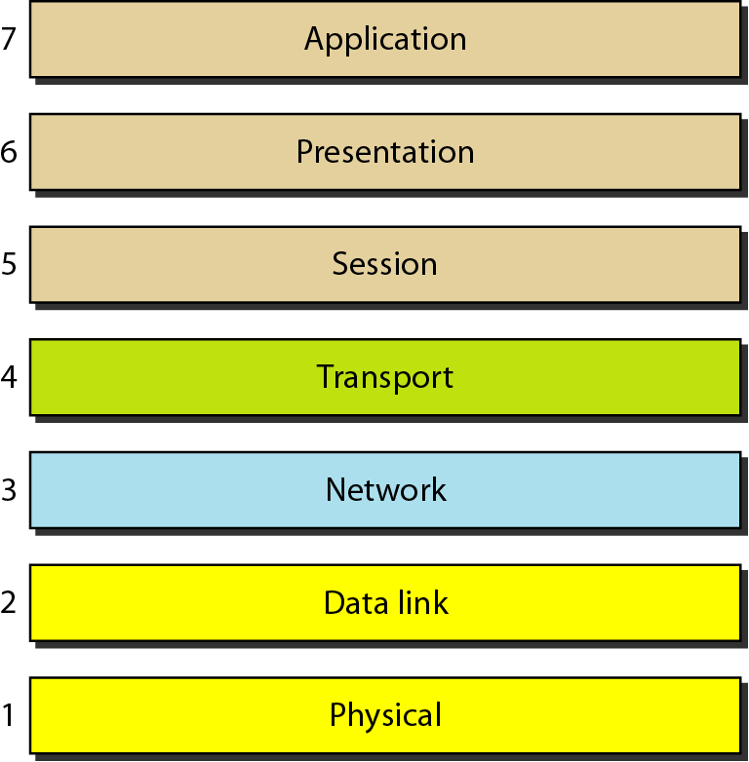
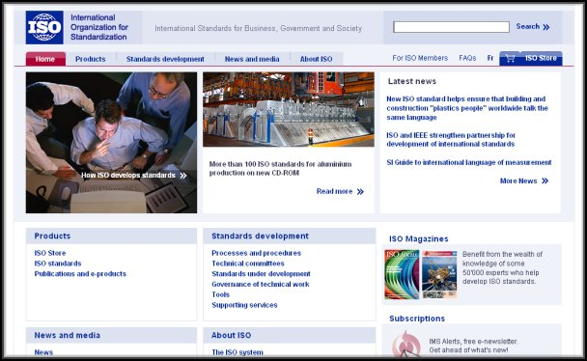
OSI Model
Open Systems Interconnection (OSI)
Seven layers
A theoretical system delivered too late!
TCP/IP is the de facto standard
Developed by the International Organization for Standardization (ISO) in 1984.
ISO is the organization. OSI is the model.

Slide 23
OSI Model - Layers
Primary Concern | Layers |  | Cisco
Communications between applications | 7 | Application | All
 | 6 | Presentation | People
 | 5 | Session | Seem
 | 4 | Transport | To
 | 3 | Network | Need
Moving raw data across the network | 2 | Data Link | Data
 | 1 | Physical | Processing

Slide 24
OSI Model - Layers
Primary Concern
Layers
Cisco
7
Application
A
ll
6
Presentation
P
eople
Communications
between
5
Session
S
eem
applications
4
Transport
T
o
3
Network
N
eed
Moving raw data
2
Data Link
D
ata
across the network
1
Physical
P
rocessing

Slide 25

An exchange using the OSI Model
Sender
Receiver
Layers
7 | Application
6 | Presentation
5 | Session
4 | Transport
3 | Network
2 | Data Link
1 | Physical
H7
D7
H7
D7
H6
D6
H6
D6
H5
D5
H5
D5
H4
D4
H4
D4
H3
D3
H3
D3
H2
D2
T2
H2
D2
T2
010
01010111100001101010101110011101
010
01010111100001101010101110011101
Transmission medium

Slide 26
Application Layer
- The 7th Layer of OSI Model
Sender
From Email/Other app
Receiver
To Email/Other app
Header
Data
Header
Data
To Presentation Layer
From Presentation Layer

Slide 27

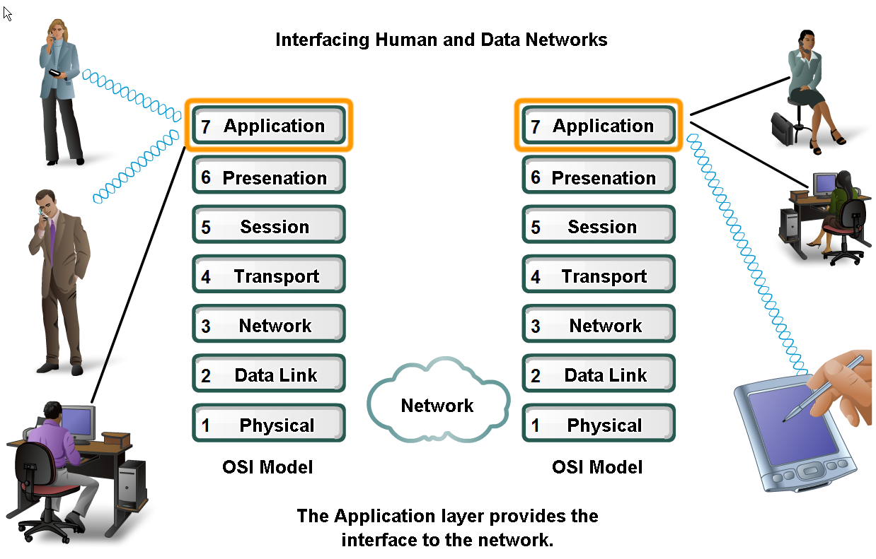

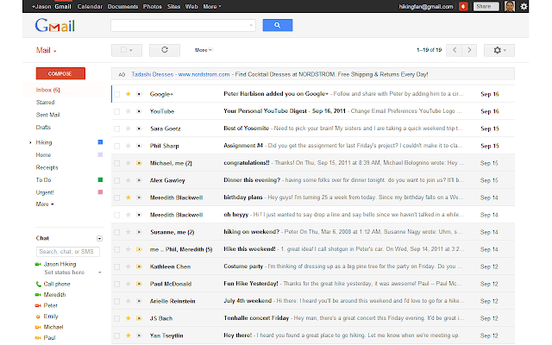
Applications
The Interface Between Human and Data Networks
Responsible for providing services to the user.
Browsers
Instant Messaging
Email

Slide 28
Examples: Application Layer Protocols
Application Layer | Name System | Host Config | Email | File Transfer | Web
 | DNS | BOOTP | SMTP | FTP | HTTP
 |  | DHCP | POP | TFTP | HTTPS
 |  |  | IMAP

Slide 29
Presentation Layer
- The 6th Layer of OSI Model
Sender
From Application Layer
Receiver
To Application Layer
Header
Data
Header
Data
To Session Layer
From Session Layer

Slide 30
Presentation Layer
The presentation layer is responsible for translation, compression, and encryption. i.e. the three primary functions
Presentation layer implementations are not typically associated with a particular protocol stack.

Slide 31
Session Layer
- The 5th Layer of OSI Model
Sender
From Presentation Layer
Receiver
To Presentation Layer
Header
Data
Header
Data
To Transport Layer
From Transport Layer

Slide 32
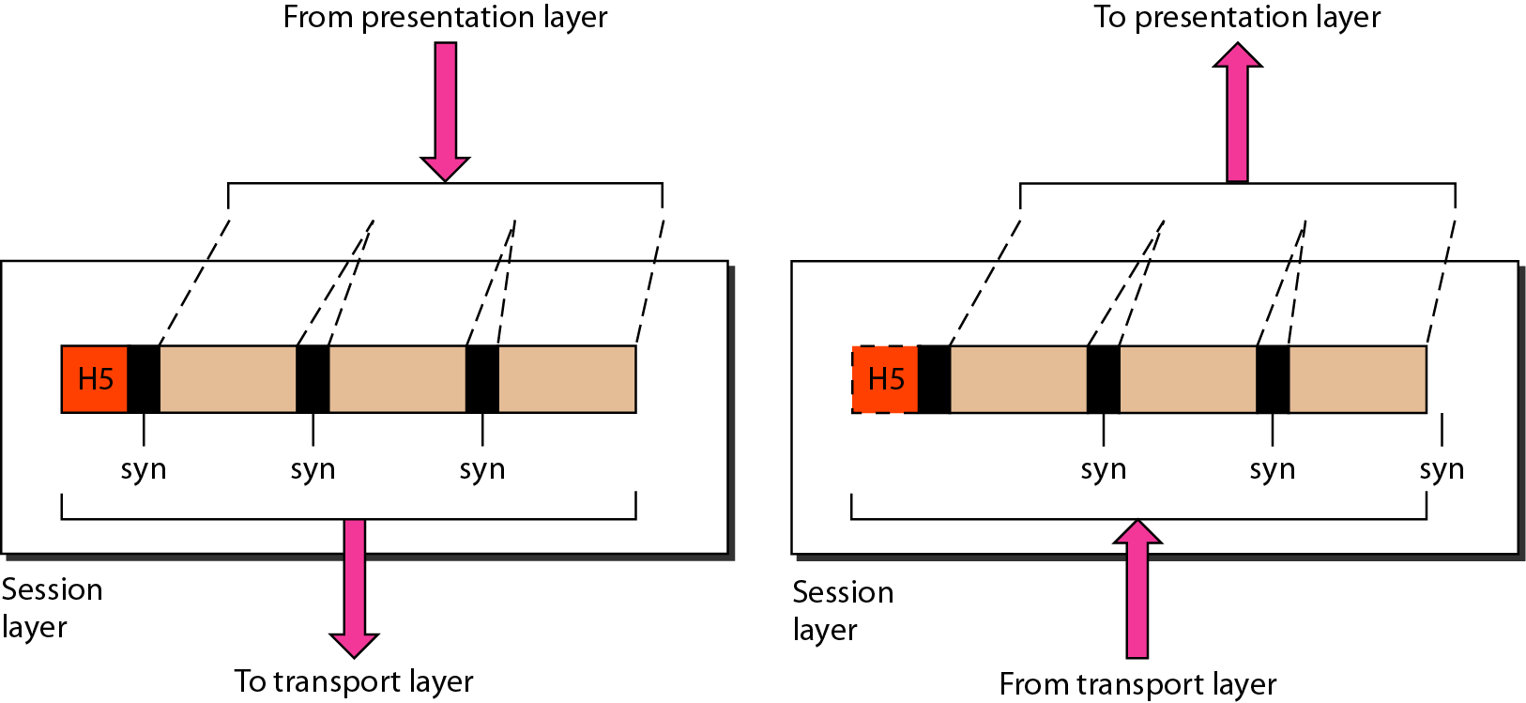
Session Layer
The session layer is responsible for dialog control and synchronization.
It handles the exchange of information
to initiate dialogs
keep them active, and
to restart sessions that are disrupted or idle for a long period of time
Most applications, like web browsers or e-mail clients, incorporate functionality of the OSI layers 5, 6 and 7.

Slide 33
Network Models & Protocol Architectures
Lecture 2 | Part 3 of 4 | CSE421 – Computer Networks
Department of Computer Science and Engineering School of Data & Science

Slide 34
Transport Layer
- The 4th Layer of OSI Model
Sender
From Session Layer
Receiver
To Session Layer
Header
Data
Header
Data
To Network Layer
From Network Layer

Slide 35
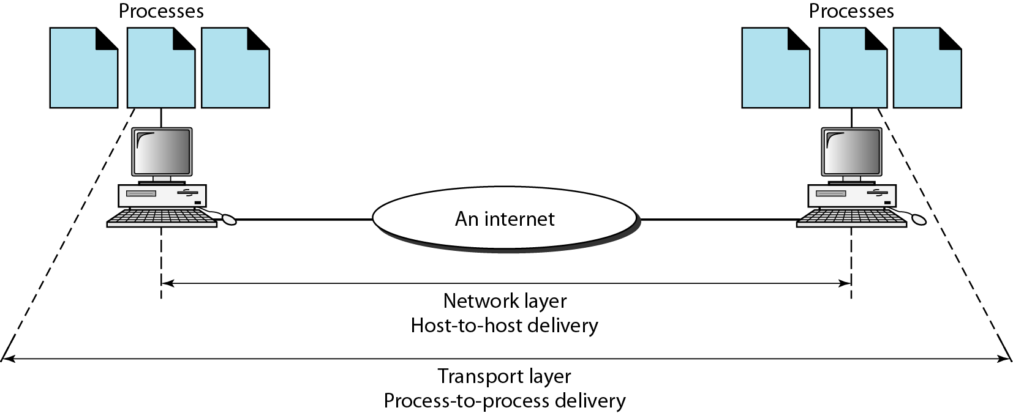
Transport Layer
The transport layer is responsible for the delivery of a message from one process (sender) to another (receiver).
Transport Layer PDU is called Segments
Functions:
Segmentation and Reassembly
Adds Port Address and Sequence Number.
Connection Control
Flow and Error Control
Multiplexing
Notes
A common protocol used in Transport Layer is TCP.
*PDU – Packet Data Unit

Slide 36
Functions – Segmentation/Reassembly
Segments data received from application layer into small parts
Steps (Sender):
Segments into small parts
Add a number to identify the application
Add a number sequence the segmented parts
What do you think will happen at the Receiver end?
Uses the sequence number to order them sequentially, merges them and sends to the upper layer
H5
Data
Segments:
H4
D_1
H4
D_2
H4
D_3
H3
D_41
H3
D_42
H3
D_43
Legend
Session Layer
Transport Layer
Network Layer

Slide 37
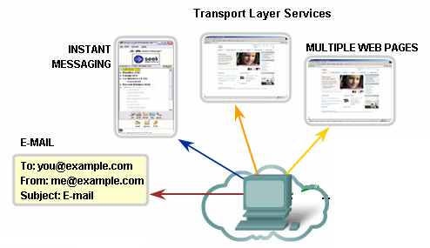
Function – Identification Using Port Address
Port Numbers/Addresses are used to identify different applications/processes running in a computer
16-bit in length
Represented as one single decimal number
e.g. 80 – Web; 23 – TCP;

Slide 38
Function – Connection Control
Establishes secure connection (TCP – Three Way Handshake)
Are you up?
Yes
1
2
3

Slide 39
Function – Flow Control
Establishes secure connection (TCP – Three Way Handshake)
At this point, this host has too many packets to process. Hence, the buffer to store incoming packets overflows.
Please, send less packets
1
2
3

Slide 40
Function – Error Control
Establishes secure connection (TCP – Three Way Handshake)
Please send Packet 2
Lost in transition
1
2
3
2
2

Slide 41
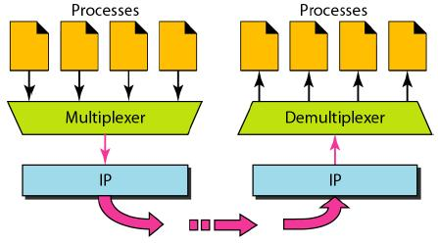
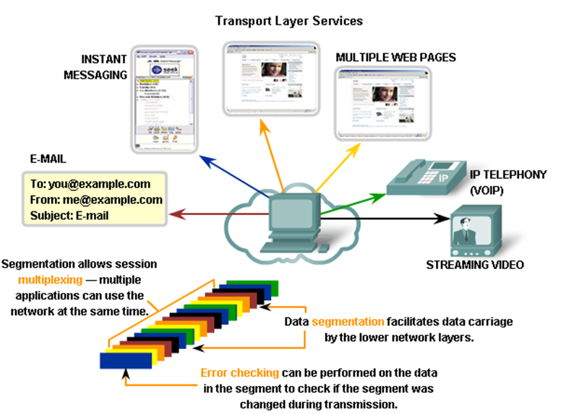
Function – Multiplexing

Slide 42
Network Layer
- The 3rd Layer of OSI Model
Sender
From Transport Layer
Receiver
To Transport Layer
Header
Data
Header
Data
To Data Link Layer
From Data Link Layer

Slide 43
Network Layer
Network Layer PDU is called Packet.
The network layer is responsible for the delivery of individual packets from the source host to the destination host.
Common Network Layer Protocol is called Internet Protocol (IP)
Functions :
Adds an address (Logical Address) to identify sender and receiver hosts.
Decides which path to take (Routing).

Slide 44
Network Layer – Logical Address
Universal address, each host uniquely defined.
32-bit address also known as IP Address.
The bits are written in dotted decimal notation. Each decimal represented by 8 bits.
Example: 192.168.10.1
Independent of underlying physical networks.

Slide 45
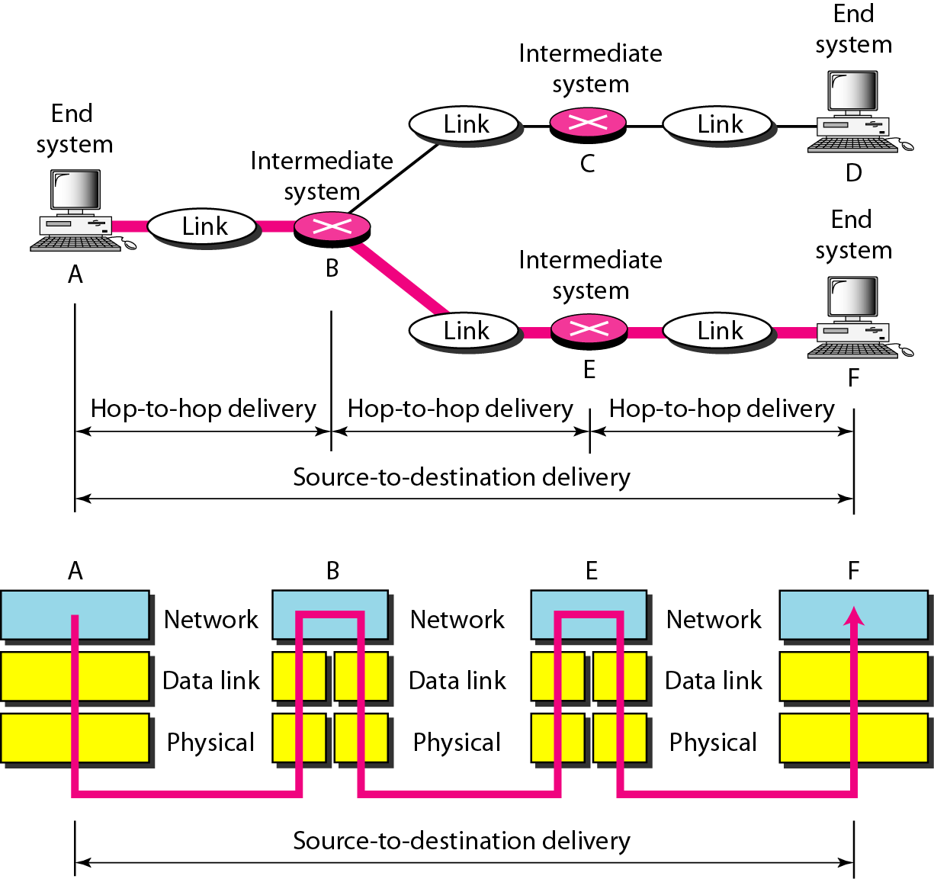
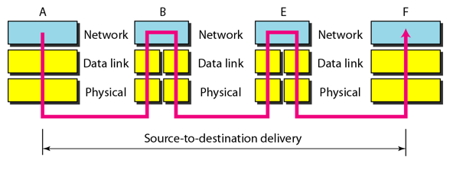
Network Layer - Example
A,B,C,D,E and F are Logical addresses
Packet to be delivered from A to F

Slide 46
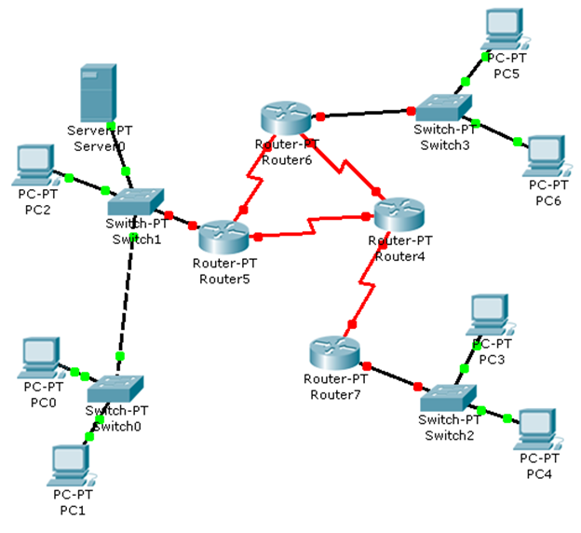
Network Layer – Another Example
LAN 1
LAN 2
Inter-connections
?
?
?
?
LAN 3
Receiver
Sender

Slide 47
Data Link Layer
- The 2nd Layer of OSI Model
Sender
From Network Layer
Receiver
To Network Layer
Header
Data
Trailer
Header
Data
Trailer
To Physical Layer
From Physical Layer

Slide 48
Data Link Layer Layer
Data Link Layer PDU is called Frame.
The data link layer is responsible for moving frames from one hop (node) to the next.
Protocols on this layer varies.
Functions :
Framing
Physical Addressing
Flow Control
Error Control
Access Control
From Network Layer
Header
Data
Trailer
To Physical Layer

Slide 49
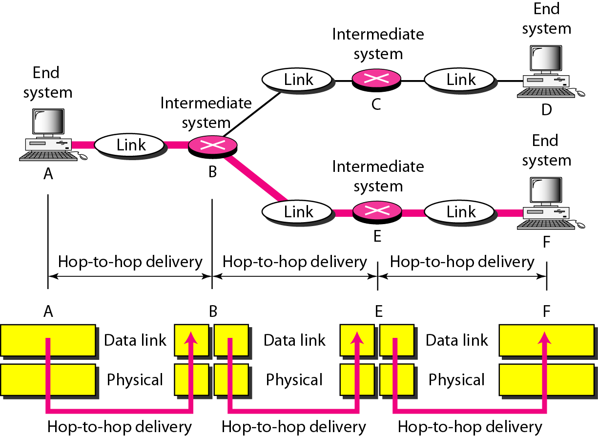
Hop-to-Hop Delivery

Slide 50
Data Link Layer – Physical Address
Also known as MAC (Media Access Control) Address
Every interface/port/device has an unique identifying number.
Given by manufacturer.
48 bits long, represented by 12 hexadecimal digits grouped in pairs and separated by ‘–’ or ‘:’ .
Example: 07:01:02:01:2C:4B

Slide 51
Physical Layer
- The 1st Layer of OSI Model
Sender
From Data Link Layer
Receiver
To Data Link Layer
0011010100
010100001111100110110111101010101001
0011010100
0101000011111001101101111010101010
To transport medium
From transport medium

Slide 52
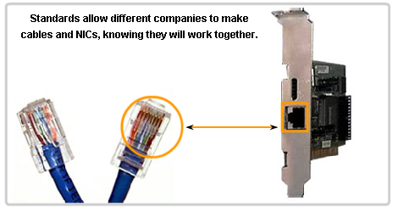
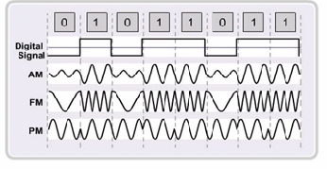
Physical Layer
The physical layer is responsible for movements of individual bits from one hop (node) to the next.
Functions
Physical Characteristics of interfaces and medium.
Representation of bits
Data Rate
Synchronization of bits

Slide 53
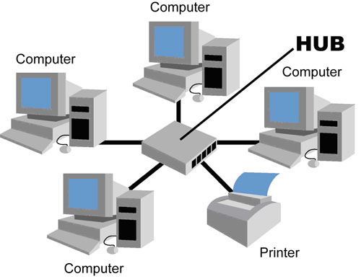
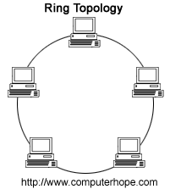
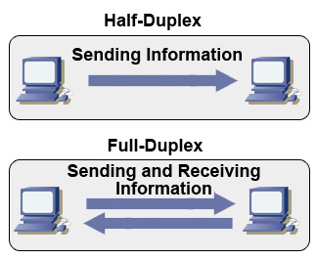
Physical Layer
Physical Topology
Example: Bus, ring, etc.
Transmission Modes
Simplex
Half Duplex
Full Duplex

Slide 54
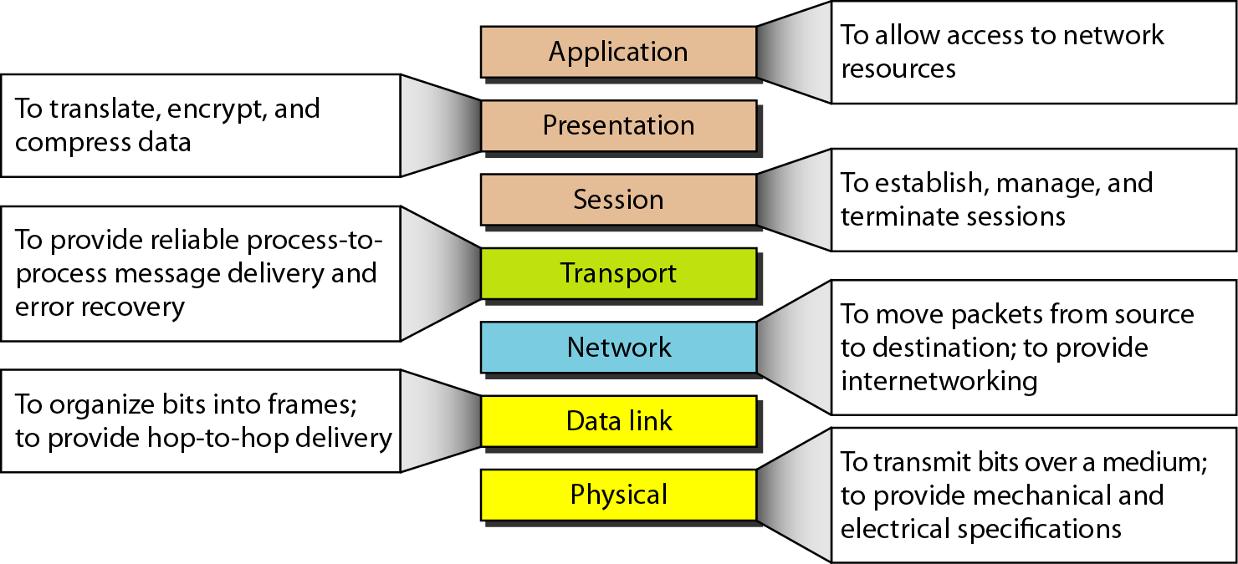
Summary of OSI Layers

Slide 55
Network Models & Protocol Architectures
Lecture 2 | Part 4 of 4 | CSE421 – Computer Networks
Department of Computer Science and Engineering School of Data & Science

Slide 56
TCP/IP Model De Facto Standard
OSI Model |  | TCP/IP Model
7 | Application | Application
6 | Presentation
5 | Session
4 | Transport | Transport
3 | Network | Internet
2 | Data Link | Network Access
1 | Physical

Slide 57
TCP/IP Model
Developed by the US Defense Advanced Research Project Agency (DARPA) for its packet switched network (ARPANET)
Used by the global Internet.
Also known as De Facto Standard.
OSI Model |  | TCP/IP Model
7 | Application | Application
6 | Presentation
5 | Session
4 | Transport | Transport
3 | Network | Internet
2 | Data Link | Network Access
1 | Physical

Slide 58


TCP/IP Encapsulation and PDU
PDU
Email Data
Data
Data
Data
Data
Passing down the stack
Transport Header
Data
Segment
Network
Header
Transport Header
Data
Packet
Frame
Header
Network
Header
Transport Header
Data
Frame
Trailer
Frame (Medium Dependent)
10011010111010101010101010101010101011010101010101010
Bits

Slide 59
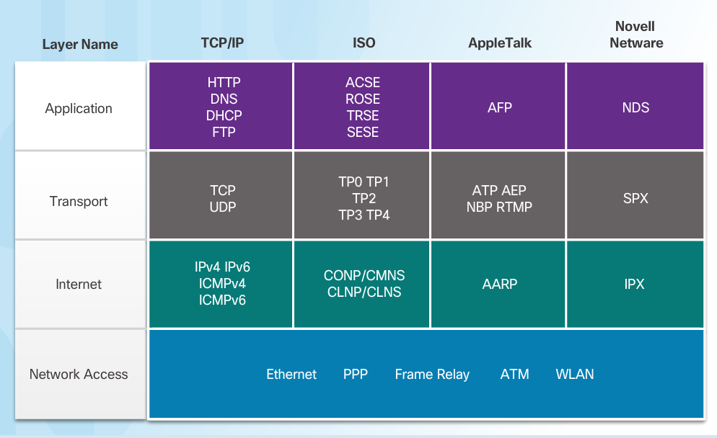
TCP/IP and Other Models

Slide 60
Addressing in Networking

Slide 61
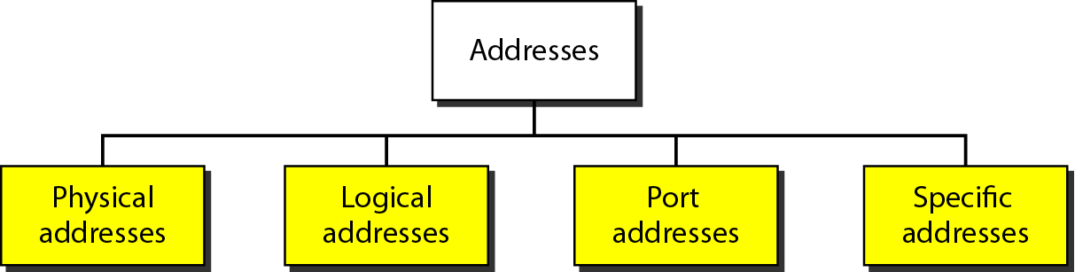
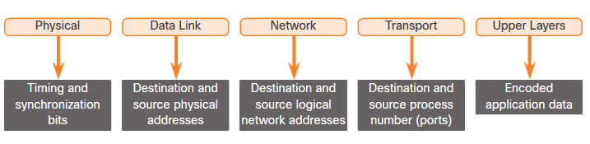
Addressing - Summary
Four levels of addresses are used in an internet employing the TCP/IP protocols

Slide 62
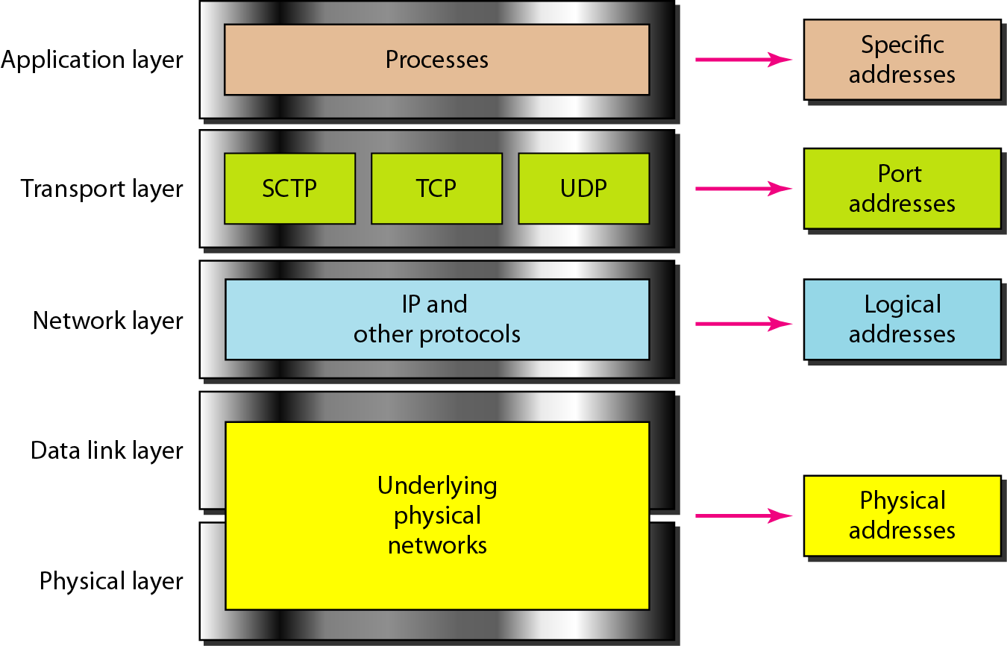
Relationship of layers and address in TCP/IP

Slide 63
Addresses
Specific Address
Applications having user friendly addresses.
Email addresses or URLs.
john@gmail.com or www.bracu.ac.bd
Theses are converted into corresponding port and logical addresses by the sending computer.
The other addresses are already discussed in the earlier slides! Can you identify them?
**Port address (Slide 35), Logical Address (Slide 42), Physical Address (Slide 48)

Slide 64
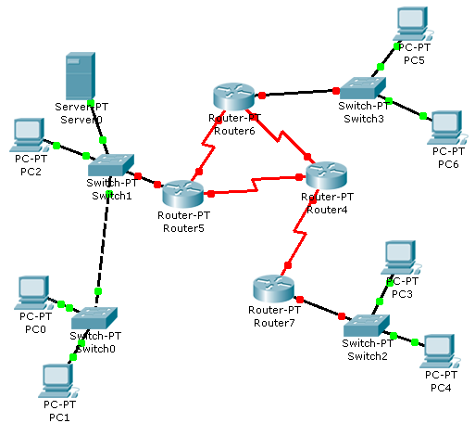
Logical and Physical Address – Same Network
Legend:
IP Addresses – Numbers
MAC Address – Alphabets
4/D
3/E
Receiver
5/A
2/C
D S S D
Sender
1/B
E
B
1
3
Data

Slide 65
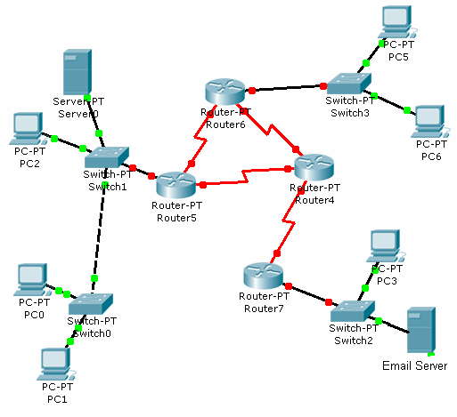
Port, Logical & Physical Address – Different Network
Legend:
IP Addresses – Numbers
MAC Address – Capital Alphabets
Port Address – Small Alphabets
G
J
A
F
0
a
k
L
H
B
1
Data
K
4/D
D S S D S D
3/E
5/A
9/H
6/F
8/J
2/C
7/G
0/L
D S S D
10/K
Receiver
Sender
1/B
Email – a
Web – c
Email – k

Slide 66
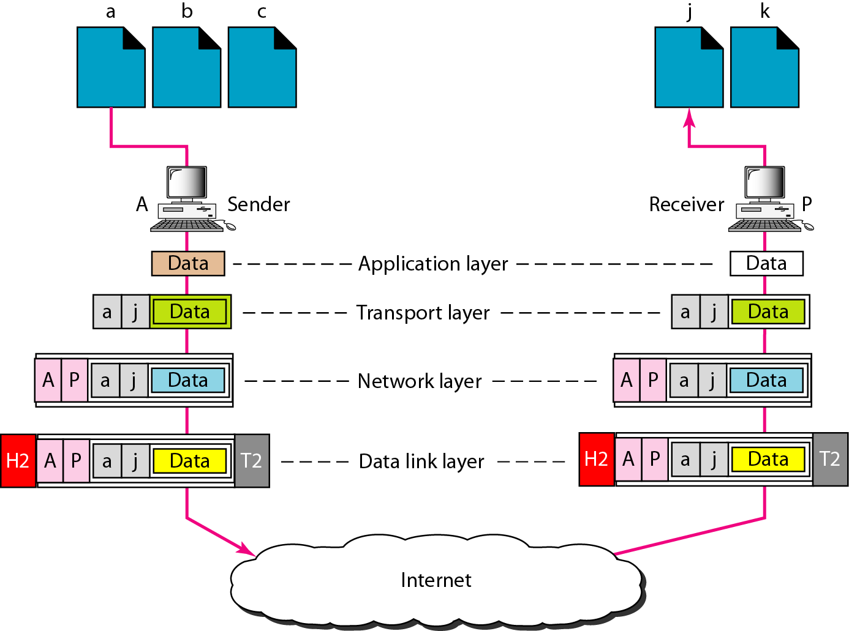
Addressing – Review
Although physical addresses change from hop to hop, logical and port addresses remain the same from the source to destination.

Slide 67
The End
References
[1] Chapter 2, The McGraw-Hill Companies, Inc.
[2] Chapter 3,The McGraw-Hill Companies, Inc.
[3] CCNA 1, CISCO.

